Slide 1
Function Examples

Slide 2
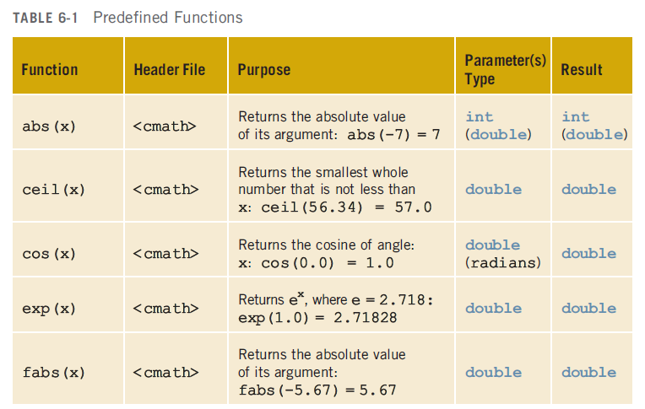
Some Built-In functions

Slide 3
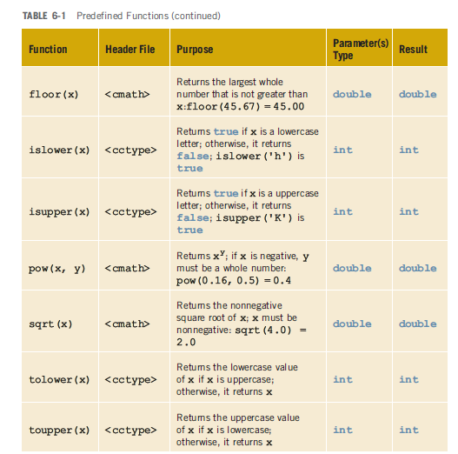

Slide 4
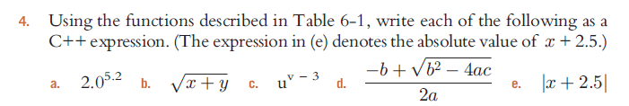
following
a
b
#include <iostream>
using namespace std;
#include <cmath>
int main(){
double x=2.0;
double y= 5.2;
double result;
result = pow(x,y);
cout<<"The result is :"<<result;
return 0;
}
#include <iostream>
using namespace std;
#include <cmath>
int main(){
double x;
double y;
double result;
cin>>x;
cin>>y;
result = sqrt(x+y);
cout<<"The result is :"<<result;
return 0;
}

Slide 5
following
c
d
#include <iostream>
using namespace std;
#include <cmath>
int main(){
double u; double v; double result;
cin>>u;
cin>>v;
result = pow(u, v-3);
cout<<"The result is :"<<result;
return 0;
}
#include <iostream>
using namespace std;
#include <cmath>
int main(){
double a, b, c;
double result;
cin>>a;
cin>>b;
cin>>c;
result = (-b + sqrt(pow(b,2) - 4*a*c))/2*a;
cout<<"\nThe result is :"<<result;
return 0;
}

Slide 6
following
e
#include <iostream>
using namespace std;
#include <cmath>
int main(){
double x, result;
cin>>x;
result = abs(x+2.5);
cout<<"The result is :"<<result;
return 0;
}

Slide 7
User-Defined Function

Slide 8
Return Tax
Tax = 5% of Income
income
Write a program using one function that calculates
tax from income amount another function that prints the tax value. The income value should be given
by the user as an input. The main program
Should call a function “Tax” that returns the
Tax value of that given income. The main program then calls another function PrintTax to print the tax value.
Main
Tax
tax
Print Tax
tax
Main
PrintTax

Slide 9
(Compute Income Tax)
#include <iostream>
#include <string>
using namespace std;
// Function Signature
double computeTaxes(double);
void printTaxes(double taxes);
int main()
{
double income;
cout << “Enter Income :";
cin >> income;
// Compute Taxes
double taxes = computeTaxes(income);
// Print employee taxes
printTaxes(taxes);
return 0;
}
double computeTax(double income)
{
double tax;
if (income<5000)
tax= 0.0;
else
tax = 0.05*income;
return tax;
}
void printTax(double taxes)
{
cout << "The taxes is $" << taxes << endl;
}

Slide 10
Piazza Price
Write a program that finds the price of pizza ordered by a customer. If a customer order one pizza the price is 20 Riyals. If two pizza are ordered then the 2nd one will have 10% discount. If more than two piazza are ordered then 20% of the 3rd one and rest have fixed price 10 Riyals.
The program should use the function calculatePrice to determine the total price for a customer order.

Slide 11
Function calculatePrice
One
How many parameters?
What are the types of parameters?
What is return?
What is the return type of the function
How to calculate the total price
int
price
double
Argument/parameter
qty
n
main
calculatePrice
price
return

Slide 12
Main program with Function calculatePrice
double calculatePrice (int n)
{
double price;
if(n==1)
price = 20;
if(n==2)
price=20+20*.9;
if(n==3)
price=20 + 20*.9 + 20*.8;
if(n>3)
price=20 + 20*.9 + 20*.8 + (n-3)*10;
return price;
}
double calculatePrice(int qty);
main()
{
double qty, price = 0.0;
cout << "How many pizza: ";
cin>>qty;
price= calculatePrice(qty);
cout<<"The total price of pizza is :"<<price;
return 0;
}

Slide 13

Car Parking(MawGif) Charge
Calculate Car parking charge based on number of hours car is parked.
2.00 SAR/hour if hours<=3
If hours (more than 3 but less the 24) then
  For each extra hour 1 SAR for more than 3 hours
if hours is 24 then 75 SAR
Argument/parameter
hour
n
main
calParkFee
fee
return

Slide 14

Gas/Benzine Charge
Calculate Gas/Benzine amount based on number of liters
Octane 95 gasoline to SR2.18
Octane 91 to SR1.53
Argument/parameter
type, liter
t, n
main
calGasPrice
fee
return

Slide 15
Calculate cube of a value
x
main
^{cube(x)}
x³
int cube(int x);
Int main(){
int result,x;
cout<<"Enter a value :";
cin>>x;
result = cube(x);
cout<<"The result is :"<<result;
return 0;
}
int cube(int x) {
return x*x*x;
}
Write a program using a function that calculates
Cubic of a number. The number should be given
by the user as an input. The main program
Should call a function “Cube” that returns the
cubic of that the given number. The main
program then print the result.

Slide 16
Sum of an Array (a)
int sum(int a[], int size);
int main(){
int a[5]={1,10,20,30,40};
int result;
result = sum(a,5);
cout<<"The result is :"<<result;
return 0;
}
int sum(int array[], int size)
{
int result=0;
for(int i=0;i<size;i++) result=result+array[i];
return result;
}
(a,n)
main
^{sum(a, n)}
^{result}
Write a program using a function that calculates
Sum of the values in of array.
The main program should pass the array to a
function “sumArray” that calculates sum of the
values in the array and returns the result to the
Main program.
The main program then prints the result.

Slide 17
Read an Array
(a, n)
main
^{read(a, size} ⁾
Display an Array
(a, n)
main
^{read(a, size} ⁾

Slide 18
Read an Array
(a, n)
main
^{read(a, size} ⁾
void readArray(int array[], int size);
int main(){
int a[100];
int n;
cout<<"How many values you want to enter ?";
cin>>n;
readArray(a,n);
return 0;
}
void readArray(int array[], int size) {
cout<<"Enter values: \n";
for(int i=0;i<size;i++)
cin>>array[i];
}
Write a program using a function “readArray” that is used to read numbers and store the numbers in an array.
The main program should pass the array to the function.
After read is complete the main program should print the values in
The array using anohter function
“displayArray”.
The main program should pass the array to the function “displayArray”.

Slide 19
Display an Array
void readArray(int array[], int size);
void displayArray(int array[], int size);
int main(){
int a[100];
int n;
cout<<"How many values you want to enter ?";
cin>>n;
readArray(a,n);
displayArray(a,n);
return 0;
}
void readArray(int array[], int size) {
cout<<"Enter values: \n";
for(int i=0;i<size;i++)
cin>>array[i];
}
Display an Array
(a, n)
main
displayArray^{(a, size )}
void displayArray(int array[], int size) { cout<<"The values in the array: \n"; for(int i=0;i<size;i++) cout<<array[i]<<"\n";
}

Slide 20
Find the largest element in an Array
(a, n)
main
^{larger(a, size} ⁾
max

Slide 21
Finding largest value in an array
void readArray(int array[], int size);
int large(int array[], int size);
int main(){
int a[100];
int n, result;
cout<<"How many values you want to enter ?";
cin>>n;
readArray(a,n);
result= large(a,n);
cout<<"The largest value is :"<<result;
return 0;
}
void readArray(int array[], int size)
{
cout<<"Enter values: \n";
for(int i=0;i<size;i++)
cin>>array[i];
}
int large(int array[], int size) {
int max=0;
for(int i=0;i<size;i++)
if (array[i]>max)
max= array[i];
return max;
}

Slide 22
Search an element in an Array
(a, x, n)
main
^{search(a, x, size} ⁾
position

Slide 23
Search a value in an array
void readArray(int array[], int size);
int searchArray(int array[], int vaue, int size);
int main(){
int a[100];
int n, result,x;
cout<<"How many values you want to enter ?";
cin>>n;
readArray(a,n);
cout<<"What value you want to search ?";
cin>>x;
result= searchArray(a,x, n);
cout<<"The value is found in position :"<<result;
return 0;
}
void readArray(int array[], int size)
{
cout<<"Enter values: \n";
for(int i=0;i<size;i++)
cin>>array[i];
}
int searchArray(int array[], int value, int size) { int result=-1;
for(int i=0;i<size;i++)
if (array[i]==value)
result= i;
return result;
}

Slide 24
Copt values from Array “a” to array “b”
(a, b, n)
main
^{copyArray(a, b, size} ⁾

Slide 25
Copy values from Array “a” to array “b”
void readArray(int array[], int size);
void displayArray(int array[], int size);
void copyArray(int array1[],int array2[], int size);
int main(){
int a[100];
int b[100];
int n;
cout<<"How many values you want to enter ?"; cin>>n;
readArray(a,n);
copyArray(a,b,n);
displayArray(b,n);
return 0;
}
void readArray(int array[], int size) {
cout<<"Enter values: \n";
for(int i=0;i<size;i++)
cin>>array[i];
}
void displayArray(int array[], int size) { cout<<"The values in the array: \n";
for(int i=0;i<size;i++)
cout<<array[i]<<"\n";
}
void copyArray(int array1[],int array2[], int size)
{
for (int i=0;i<size;i++){
array2[i]=array1[i];
}
}

Slide 26
Swap two variables values
(x, y)
main
^{swap(x, y)}
void swap(int &x, int &y);
int main(){
int a; int b;
cout<<"Enter values for a and b: \n";
cin>>a>>b;
cout<<"Output before swap :\n";
cout<<a<<", "<<b;
swap(a,b);
cout<<"\nOutput after swap :\n";
cout<<a<<", "<<b; return 0;
}
void swap(int &x, int &y){
int temp;
temp=x;
x=y;
y=temp;
}

Slide 27
A function to calculate grade
(mark)
main
^{grade(mark)}
grade

Slide 28
A function to calculate grade
string showGrade(int grade){
string result;
if(grade>=90)
result= "A+";
else if (grade>=85)
result = "A";
else if (grade>=80)
result = "B+";
else if (grade>=80)
result = "B";
else if (grade>=75)
result = "C+";
else if (grade>=70)
result = "C";
else if (grade>=60)
result = "D";
else result ="F";
return result; }
string showGrade(int grade);
int main(){
int mark;
string result;
cout<<"Enter your mark: \n";
cin>>mark;
result= showGrade(mark);
cout<<"Your grade is : "<<result;
return 0;
}

Slide 29
Passing String var to function
Write program using function to print names as “Tareq, Mohammad”.
Input: First name and Last Name
Output: Last Name, First Name;
Must use function for input and output.
InputName
main
PrintName

Slide 30
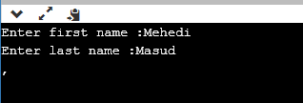
code
#include <iostream>
using namespace std;
#include <string>
string outputName(string f, string l);
void inputName(string f, string l);
int main() {
string name;
string fname, lname;
inputName(fname,lname);
name = outputName(fname,lname);
cout<<name;
return 0;
}
void inputName(string f , string l){
cout<<"Enter first name :";
cin>>f;
cout<<"Enter last name :";
cin>>l;
}
string outputName(string f, string l){
string name;
name= l+", "+ f;
return name;
}
What is wrong?
Output

Slide 31

code
#include <iostream>
using namespace std;
#include <string>
string outputName(string &f, string &l);
void inputName(string f, string l);
int main() {
string name;
string fname, lname;
inputName(fname,lname);
name = outputName(fname,lname);
cout<<name;
return 0;
}
void inputName(string &f , string &l){
cout<<"Enter first name :";
cin>>f;
cout<<"Enter last name :";
cin>>l;
}
string outputName(string f, string l){
string name;
name= l+", "+ f;
return name;
}
Output

Slide 32

Static Variable
#include <iostream>
#include <string>
using namespace std;
void demo()
{
// static variable
static int count = 0;
cout << count << " ";
count++;
}
int main()
{
for (int i=0; i<5; i++)
demo();
return 0;
}
#include <iostream>
#include <string>
using namespace std;
void demo()
{
int count = 0;
cout << count << " ";
count++;
}
int main()
{
for (int i=0; i<5; i++)
demo();
return 0;
}

Slide 33
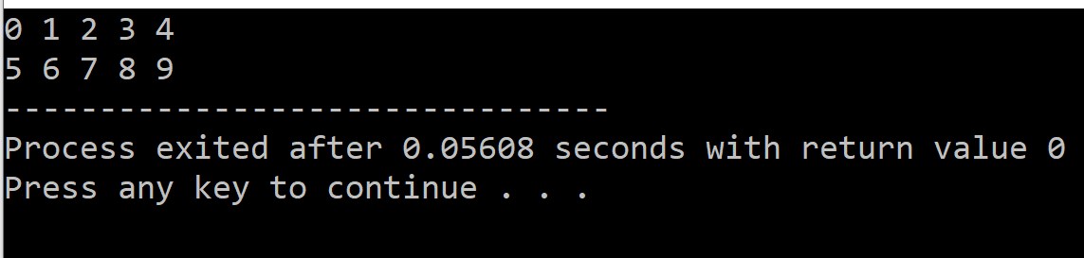
Static Variable
#include <iostream>
#include <string>
using namespace std;
int static count = 0;
void demo()
{
cout << count << " ";
count++;
}
void demo2()
{
cout << count << " ";
count++;
}
int main()
{
for (int i=0; i<5; i++)
demo();
cout<<"\n";
for (int i=0; i<5; i++)
demo2();
return 0;
}

Slide 34
Static Variable
#include <iostream>
#include <string>
using namespace std;
int static count = 0;
void demo()
{
cout << count << " ";
count++;
}
void demo2()
{
int count=0;
cout << count << " ";
count++;
}
int main()
{
for (int i=0; i<5; i++)
demo();
cout<<"\n";
for (int i=0; i<5; i++) demo2();
return 0;
}

